Slide 1
Carbon Risk Real Estate Monitor CRREM
Prof. Dr. Sven Bienert, Dr. Paloma Taltavull de la Paz IRE|BS International Real Estate Business School, University of Alicante
34th Annual Meeting of the American Real Estate Society, Bonita Springs, April 10th – 14th 2018
Notes:
March 25, 2000
1

Slide 2
Downside Risks of Climate Change

Slide 3
Objectives
CRREM: Carbon Risk Real Estate Monitor - Framework for science based decarbonisation pathways, toolkit to identify stranded assets and push sustainable investments
(February 2018 – January 2021)
The project is funded by the Horizon 2020 Framework Programme of the European Union.
General Objectives:
Objective 1 – Downscaling & transparency: Breaking down INDCs by sector, company and property level for more transparency and capacity building
Objective 2 – Strategic implication of “Stranded assets”: Defining areas for improvement and strategic options
Objective 3 – Framework, Toolkits & Methods: Making decarbonisation in the commercial real estate sector measurable

Slide 4
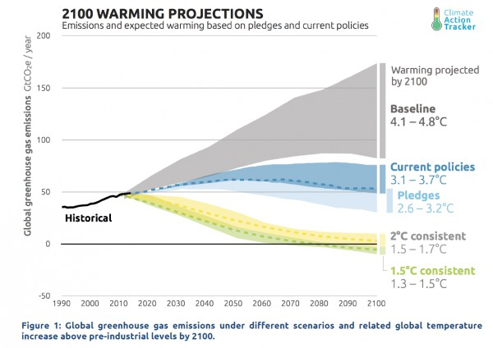
Science Based Targets (SBT)
Current INDC pledges will not meet the 2°C aim (3.2°C instead, according to Climate Action Tracker)
Source: Climate Action Tracker, 2017
Notes:
Targets are “considered ’science based’ if they are in line with the level of decarbonization required to keep global temperature increase below 2°C compared to preindustrial temperatures”
SDA: “A method for setting corporate emission reduction targets in line with climate science”
Sector budgets according to “International Energy Agency: Energy Technology Perspectives 2014” for Trade/Retail, Finance, Real estate, Public administration, Health, Food and lodging, Education, Other commercial services
SDA combines a subsector-level approach and a global least-cost mitigation perspective based on mitigation potentials and costs → help companies to align their emissions reduction targets with a global 2°C pathway
Covering scope 1 and 2 emissions
Based on the IEA 2°C scenario which is consistent with the Representative Concentration Pathway 2.6 (RCP 2.6) Scenario from the IPCC’s Fifth Assessment Report:
“Unlikely” (0-33% probability) that temperature increase > 2°C
IPCC (2013): “Warming is largely independent of the emission profile. […] More emissions early imply stronger reductions later. Any temperature target implies a maximum in cumulative CO₂ emissions.”
Overall remaining carbon budget (2011 - 2050): 1,055 GtCO₂ (currently approx. 50 GtCO₂ per year) share of “Services / commercial buildings”: 32 GtCO₂

Slide 5
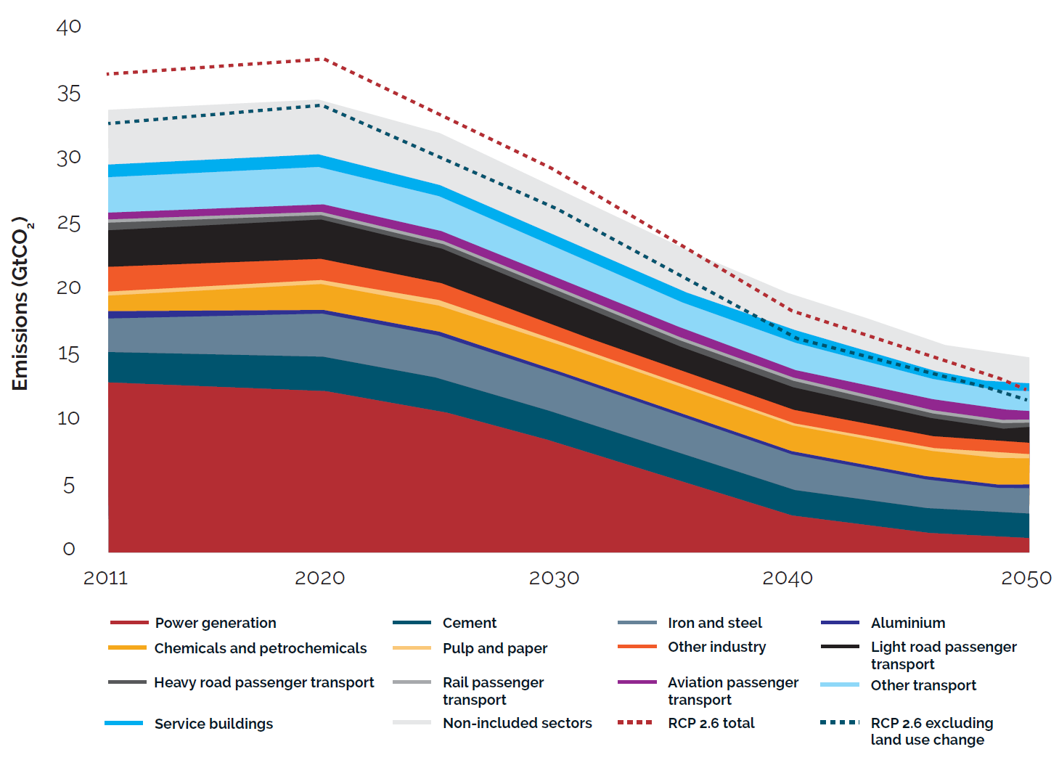
Sectoral decarbonization approach (SDA)
Sectoral breakdown of absolute CO2 emissions budget, 2011–50
Source: SBT, 2015

Slide 6
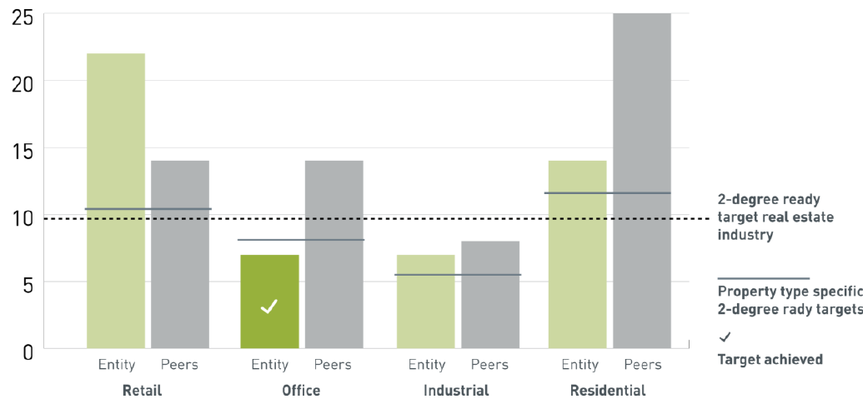
Emission breakdown according to types of use
Breakdown to different types of use: Cooperation with GRESB
Source: GRESB

Slide 7
Stranding Risk
Emission intensity
[kgCO_{2e} /m²a]
Stranding 1
Effect of climate change (HDD/CDD!)
Asset
Constant Emissions
Stranding 2
Retrofit 1
Retrofit 2
Sector decarbonisation
2050
Year
Source: Own presentation

Slide 8
General approach
Main objective: Development of the CRREM-Tool
Aggregated level | Industry (Commercial Real Estate)
World 2°C target → IPCC, RCP 2.6 | Company
Countries / EU INDC‘s → 3,2°C Country breakdown | Portfolio
Sector SDA, GRESB | Asset Scope 1, 2
SDA / SBT*
Company
pilot
Portfolio
pilot
Asset
pilot
Benchmarking
*SDA / SBT: Sectoral Decarbonisation Approach / Science Based Targets
Source: Own presentation
Notes:
accelerate the decarbonization and climate change resilience of the EU real estate sector
providing appropriate science-based carbon reduction pathways
property, portfolio and company level
framework for financial risk assessment
efficiency and retrofit requirements
communicating the downside financial risks
stricter regulatory environment
risk of stranded-assets

Slide 9
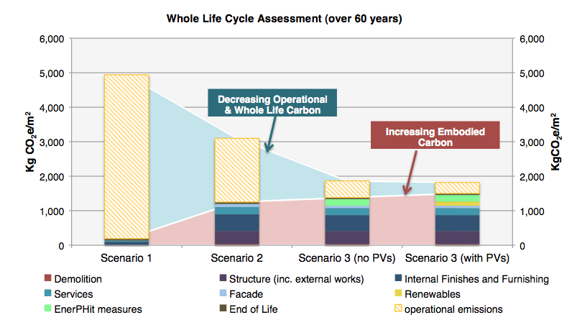
Embodied Carbon of retrofits
Double or triple glazing
60 years life cycle
Benefit of 3rd sheet = 11,661 kgCO₂e
Cost of 3rd sheet = 13,193 kgCO₂e
Source: Sturgis Carbon Profiling, 2018

Slide 10
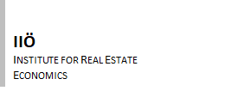
Project partners
IIÖ / Austria
University of Alicante / Spain
TIAS / Tilburg University / NL
Ulster University / UK
GRESB
Sturgis Carbon Profiling / UK

Slide 11
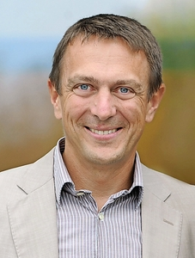
Contact
Thanks for your attention!
Contact:
Prof. Dr. Sven Bienert, MRICS REV
sven.bienert@irebs.de
+49 941 943-6011
http://bienert.irebs.de

